Slide 1

Chapter 3
Planning and Managing the Project
This lecture is based on the Chapter 3 of the book “Software Engineering: Theory and Practice”.

Slide 2
Contents
3.1 Tracking Progress
3.2 Project Personnel
3.3 Effort Estimation
3.4 Risk Management
3.5 The Project Plan

Slide 3
Chapter 3 Objectives
Tracking project progress
Project personnel and organization
Effort and schedule estimation
Risk management

Slide 4
3.1 Tracking Progress
Do we understand customer’s needs?
Can we design a system to solve customer’s problems or satisfy customer’s needs?
How long will it take to develop the system?
How much will it cost to develop the system?

Slide 5
3.1 Tracking Progress
Project Schedule
Describes the software-development cycle for a particular project by
  enumerating the phases or stages of the project
  breaking each phase into discrete tasks or activities to be completed
Portrays the interactions among the activities and estimates the times that each task or activity will take

Slide 6
3.1 Tracking Progress
Milestones and activities
Activity: takes place over a period of time
Milestone: completion of an activity -- a particular point in time
Precursor: event or set of events that must occur in order for an activity to start
Successor: event or set of events that occur when an acitivity is completed
Duration: length of time needed to complete an activity
Due date: date by which an activity must be completed

Slide 7
3.1 Tracking Progress
Project Schedule: Approach
Understanding customer’s needs by listing all project deliverables
  Documents
  Demonstrations of function
  Demonstrations of subsystems
  Demonstrations of accuracy
  Demonstrations of reliability, performance or security
Determining milestones and activities to produce the deliverables

Slide 8
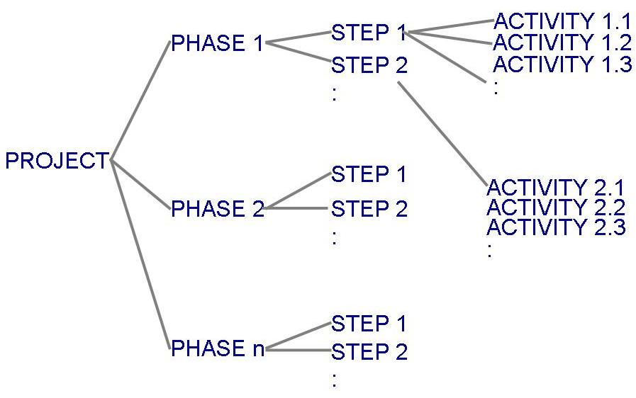
3.1 Tracking Progress
Project Schedule (continued)
Project development can be separated into a succession of phases which are composed of steps, which are composed of activities

Slide 9
3.1 Tracking Progress
Phases, Steps, and Activities in Building a House
Table 3.1 shows the phases, steps and activities to build a house
  landscaping phase
  building the house phase

Slide 10
3.1 Tracking Progress
Milestones in Building a House
Table 3.2 lists milestones for building the house phase

Slide 11
3.1 Tracking Progress
Work Breakdown and Activity Graphs
Work breakdown structure depicts the project as a set of discrete pieces of work
Activity graphs depict the dependencies among activities
  Nodes: project milestones
  Lines: activities involved

Slide 12
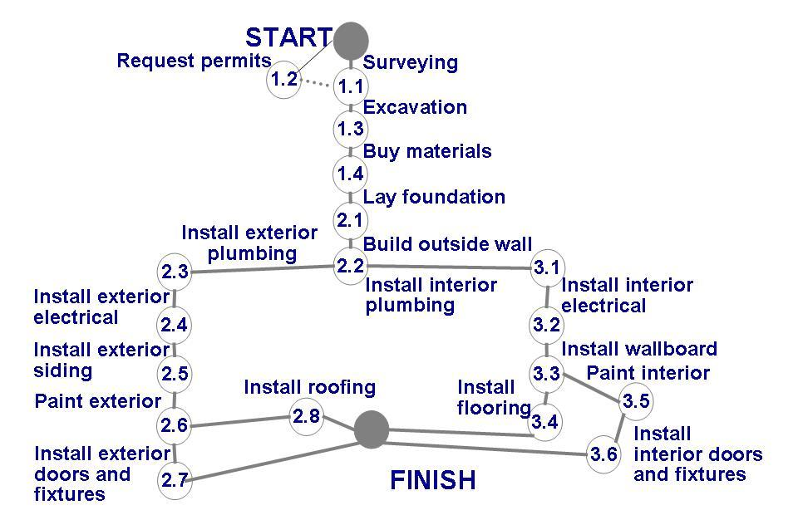
3.1 Tracking Progress
Work Breakdown and Activity Graphs (continued)
Activity graph for building a house

Slide 13
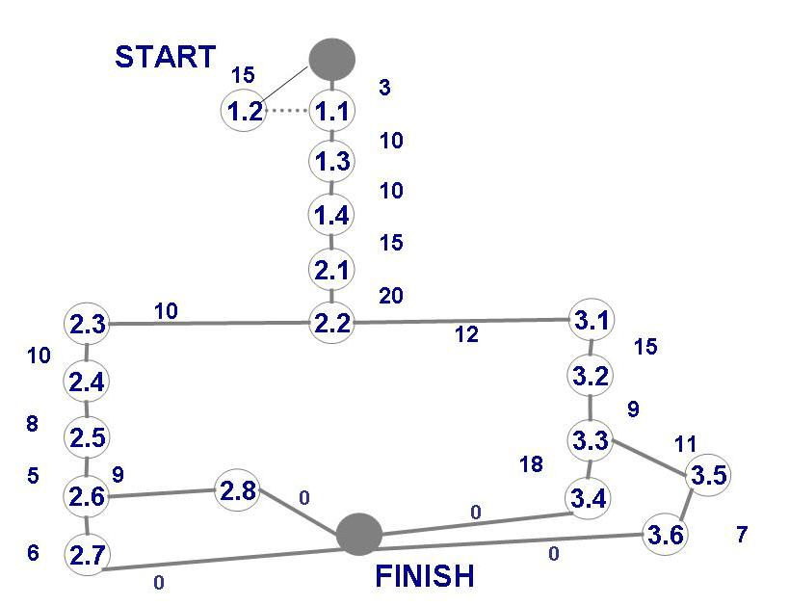
3.1 Tracking Progress
Estimating Completion
Adding estimated time in activity graph of each activity to be completed tells us more about the project's schedule

Slide 14
3.1 Tracking Progress
Estimating Completion for Building a House

Slide 15
3.1 Tracking Progress
Estimating Completion
How many days are required to complete the phrase 2?
  Start-1.1: 3 days
  Start-1.2: 15 days
  1.2-1.3-1.4-2.1-2.2: 55 days
  2.2-2.3-2.4-2.5-2.6-2.7: 39 days
  2.2-2.3-2.4-2.5-2.6-2.8: 42 days
  2.2-3.1-3.2-3.3-3.4: 54 days
  2.2-3.1-3.2-3.3-3.5-3.6: 54 days
  1.2-1.3-1.4-2.1-2.2-3.1-3.2-3.3-3.4: 15+55+54=124 days
  1.2-1.3-1.4-2.1-2.2-3.1-3.2-3.3-3.5-3.6: 15+55+54=124 days

Slide 16
3.1 Tracking Progress
Critical Path Method (CPM)
Minimum amount of time it will take to complete a project
  Reveals those activities that are most critical to completing the project on time
Real time (actual time): estimated amount of time required for the activity to be completed
Available time: amount of time available in the schedule for the activity's completion
Slack time: the difference between the available time and the real time for that activity

Slide 17
3.1 Tracking Progress
Critical Path Method (CPM) (continued)
Critical path: the slack at every node is zero
  can be more than one in a project schedule
Slack time = available time – real time
= latest start time – earliest start time

Slide 18
Slack Time for Activities of Building a House
1.2-1.3-1.4-2.1-2.2-3.1-3.2-3.3-3.4, 1.2-1.3-1.4-2.1-2.2-3.1-3.2-3.3-3.5-3.6
  Critical path: 1.2-1.3-1.4-2.1-2.2-3.1-3.2-3.3-3.4,
  1.2-1.3-1.4-2.1-2.2-3.1-3.2-3.3-3.5-3.6, 124 days

Slide 19
3.1 Tracking Progress
Exercises 1
You are about to bake a two-layer birthday cake with icing. Describe the cake-baking project as a work breakdown structure. Generate an activity graph from that structure. What is the critical path?

Slide 20
3.1 Tracking Progress
Exercises 1 (continued)
Step 1: define phrases, steps and activities.
  Phrase 1: prepare
    Step 1.1: choose recipe
      Activity A: choose recipe
    Step 1.2: prepare ingredients and baking cookware
      Activity B: assemble cake ingredients
      Activity C: prepare cake pan
      Activity D: preheat oven
      Activity E: mix dry ingredients
      Activity F: mix wet ingredients
      Activity G: fold wet ingredients into dry ingredients
      Activity J: assemble icing ingredients
      Activity K: mix icing

Slide 21
3.1 Tracking Progress
Exercises 1 (continued)
  Phrase 2: Bake cake with icing
    Step 2.1: bake cake
      Activity H: pour batter into pan
      Activity I: bake cake
    Step 2.2: Apply ice
      Activity L: cool cake
      Activity M: apply icing

Slide 22
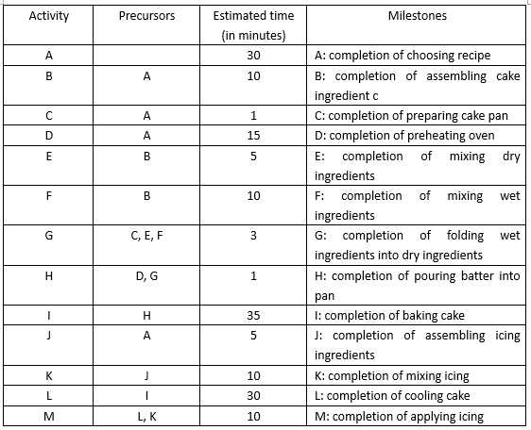
3.1 Tracking Progress
Exercises 1 (continued)
Step 2: determine dependence and estimated time of activities.

Slide 23

Open Question
Points: 10
Draw an activity graph for the baking cake project.
Open Question is only supported on Version 2.0 or newer.
Answer

Slide 24
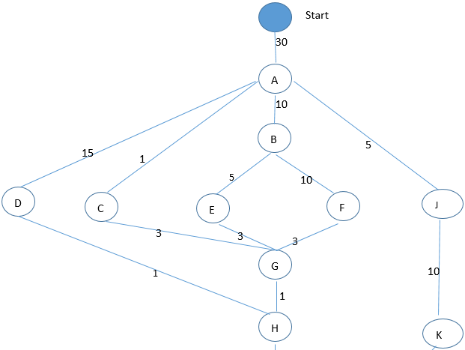
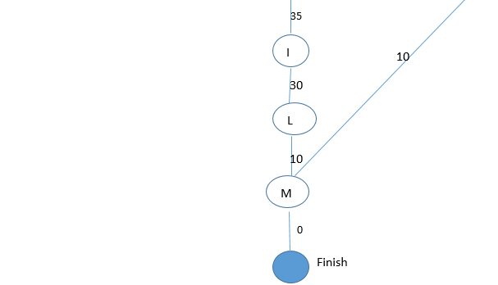
3.1 Tracking Progress
Exercises 1 (continued)
Step 3: draw activity graph.

Slide 25
3.1 Tracking Progress
Exercises 1 (continued)
Step 4: Find the critical path.
  Method 1: find all the possible path and choose the path which takes the longest time.
    Path 1: A-J-K-M, 55mins
    Path 2: A-D-H-I-L-M, 121mins
    Path 3: A-C-G-H-I-L-M, 110mins
    Path 4: A-B-F-G-H-I-L-M, 129mins, Critical path
    Path 5: A-B-E-G-H-I-L-M, 124mins

Slide 26
3.1 Tracking Progress
Exercises 1 (continued)
  Method 2: calculate slack time and choose the path for which the slack at every node is zero .
    Slack time = latest start time – earliest start time
    earliest start time = max{ the time spent to complete precursors}+1 (from start to finish)
    Eg. For activity G, its precursors are C,E,F.
    earliest start time =max{C,E,F}+1=max{31,45,50}+1=51

Slide 27
3.1 Tracking Progress
Exercises 1 (continued)
    latest start time = min{latest start time of successors}-estimated time
    Method: calculate the latest start time from the finish state to start. For the finish state, latest start time =earliest start time.
    eg. For activity M, its successor is finish state
    latest start time =min{130}-10=120
    eg. For activity B, its successors are E, F
    latest start time =min{E, F}-10
    =min{46, 41}-10=31

Slide 28
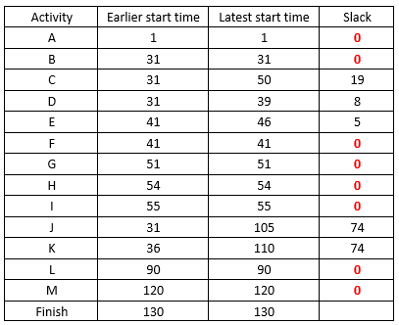
3.1 Tracking Progress
Exercises 1 (continued)
Table shows the earlier start time, latest start time, slack.

Slide 29
Assignment 1
Book “Software engineering: theory and practice”, Chapter 3, Section 3.14 , pp: 138
  Exercise 2
  Exercise 3
Send by email:
ieljzhou@zzu.edu.cn
Due date: March 31, 2022

Slide 30
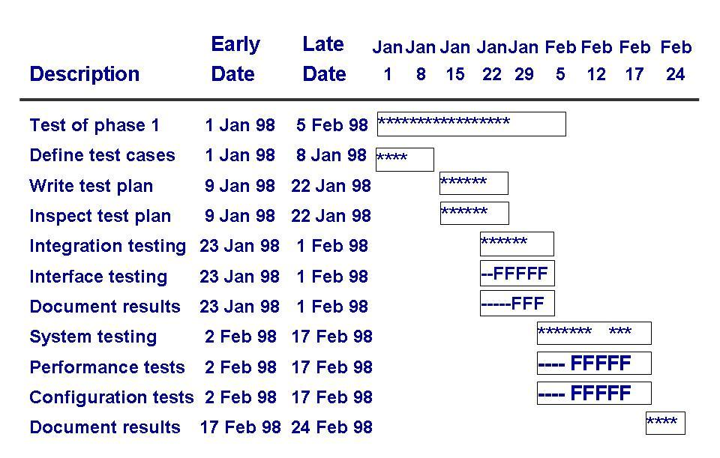
3.1 Tracking Progress
CPM Bar Chart
Including information about the early and late start dates
Asterisks indicate the critical path

Slide 31
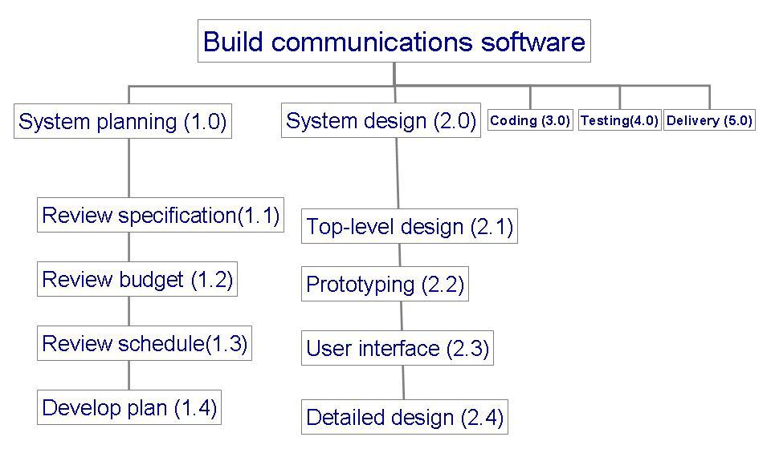
3.1 Tracking Progress
Tools to Track Progress
Example: to track progress of building a communication software

Slide 32
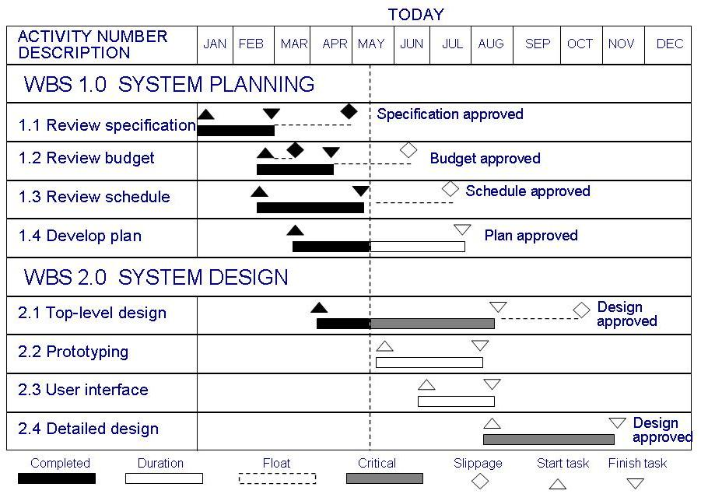
3.1 Tracking Progress
Tools to Track Progress: Gantt Chart
Activities shown in parallel
  helps understand which activities can be performed concurrently

Slide 33
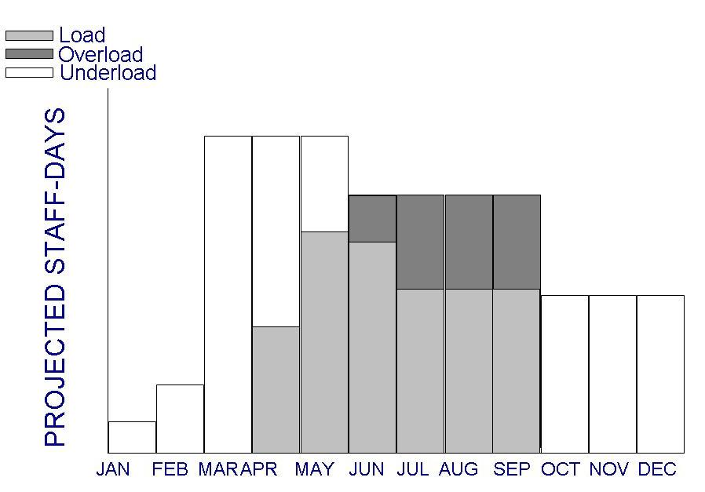
3.1 Tracking Progress
Tools to Track Progress: Resource Histogram
Shows people assigned to the project and those needed for each stage of development

Slide 34
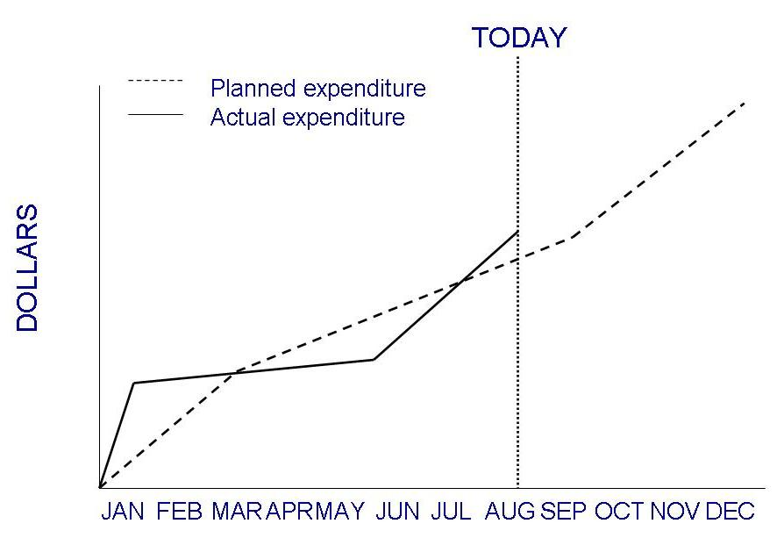
3.1 Tracking Progress
Tools to Track Progress: Expenditures Tracking
An example of how expenditures can be monitored

Slide 35
3.2 Project Personnel
Key activities requiring personnel
  requirements analysis
  system design
  program design
  program implementation
  testing
  training
  maintenance
  quality assurance
There is great advantage in assigning different responsibilities to different people

Slide 36
3.2 Project Personnel
Choosing Personnel
Ability to perform work
Interest in work
Experience with
  similar applications
  similar tools, languages, or techniques
  similar development environments
Training
Ability to communicate with others
Ability to share responsibility
Management skills

Slide 37
3.2 Project Personnel
Communication
A project's progress is affected by
  degree of communication
  ability of individuals to communicate their ideas
Software failures can result from breakdown in communication and understanding

Slide 38
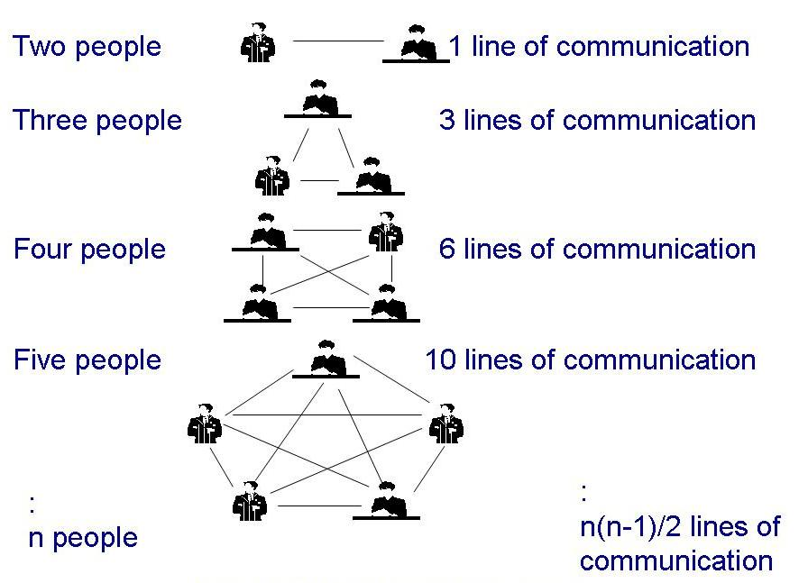
3.2 Project Personnel
Communication (continued)
Line of communication can grow quickly
If there is n worker in project, then there are n(n-1)/2 pairs of communication

Slide 39
3.2 Project Personnel
Work Styles
Extroverts: tell their thoughts
Introverts: ask for suggestions
Intuitives: base decisions on feelings
Rationals: base decisions on facts, options

Slide 40
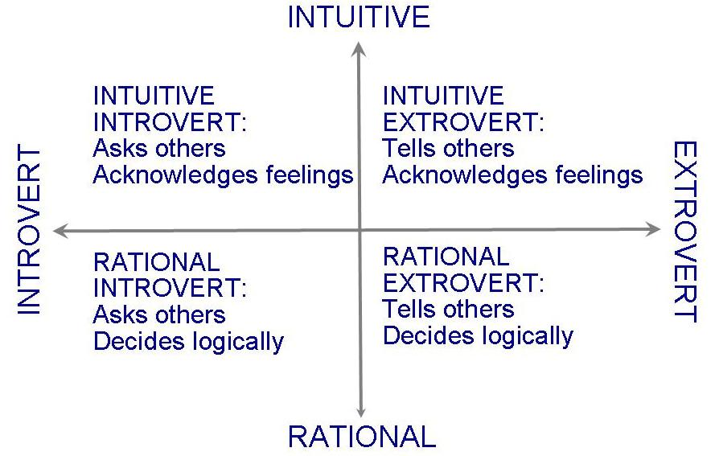
3.2 Project Personnel
Work Styles (continued)
Horizontal axis: communication styles
Vertical axis: decision styles

Slide 41
3.2 Project Personnel
Project Organization
Depends on
  backgrounds and work styles of team members
  number of people on team
  management styles of customers and developers
Examples:
  Chief programmer team: one person totally responsible for a system's design and development
  Egoless approach: hold everyone equally responsible

Slide 42
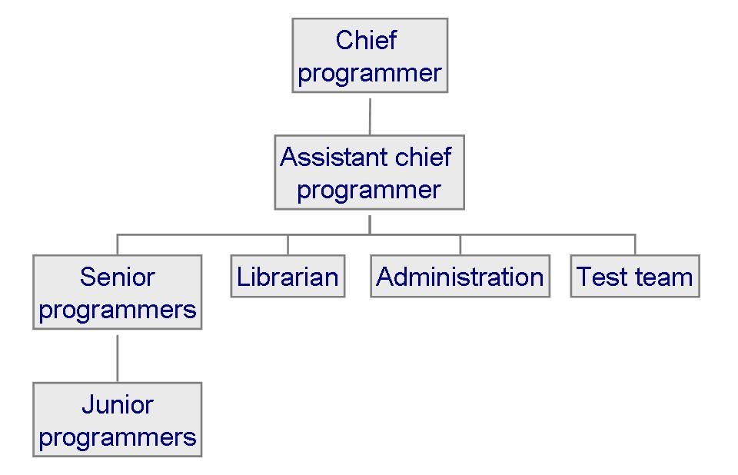
3.2 Project Personnel
Project Organization: Chief Programmer Team
Each team member must communicate often with chief, but not necessarily with other team members

Slide 43
3.2 Project Personnel
Project Organization (continued)
Characteristics of projects and the suggested organizational structure to address them

Slide 44
3.3 Effort Estimation
Estimating project costs is one of the crucial aspects of project planning and management
Estimating cost has to be done as early as possible during the project life cycle
Type of costs
  facilities: hardware, space, furniture, telephone, etc
  software tools for designing software
  staff (effort): the biggest component of cost

Slide 45
3.3 Effort Estimation
Type of Estimation Methods
Expert judgment
  Top-down or bottom-up
  Analogy: pessimistic (x), optimistic (y), most likely (z); estimate as (x + 4y + z)/6
  Delphi technique: based on the average of “secret” expert judgments
Algorithmic methods: E = (a + bS^{c}) m(X)
Machine learning method
  Neural network: cause-effect network “trained” with data from past history

Slide 46
3.4 Risk Management
What is a Risk?
Risk is an unwanted event that has negative consequences
Distinguish risks from other project events
  Risk impact: the loss associated with the event
  Risk probability: the likelihood that the event will occur
Quantify the effect of risks
  Risk exposure = (risk probability) x (risk impact)
Risk sources: generic and project-specific

Slide 47
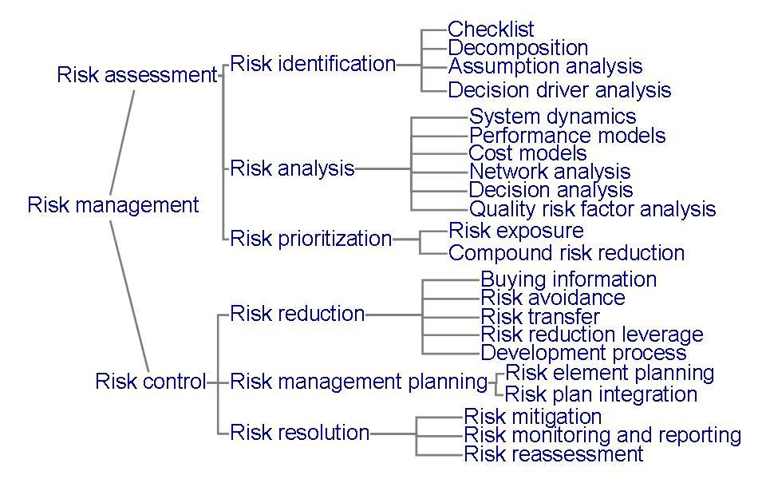
3.4 Risk Management
Risk Management Activities

Slide 48
3.5 Project Plan
Project Plan Contents
Project scope
Project schedule
Project team organization
Technical description of system
Project standards and procedures
Quality assurance plan
Configuration management plan
Documentation plan
Data management plan
Resource management plan
Test plan
Training plan
Security plan
Risk management plan
Maintenance plan

Slide 49
3.5 Project Plan
Project Plan Lists
List of the people in development team
List of hardware and software
Standards and methods, such as
  algorithms
  tools
  review or inspection techniques
  design language or representaions
  coding languages
  testing techniques

Slide 50
Summary
Key concepts in project management
  Schedule estimation
    Critical path method
  Team Organization
  Cost estimation
  Risk management

